Slide 1


Blue/Green Deployment and Serverless Microservices Architecture Patterns
Udayakumar Mathivanan
Cloud Solution Architect

Slide 2
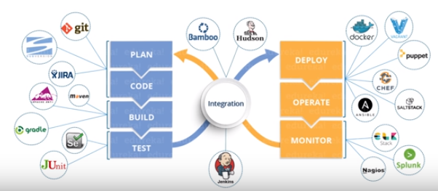
DevOps Phases &Tools

Slide 3
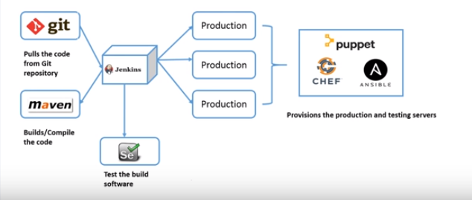
Implementation of DevOps – A Use case Example

Slide 4
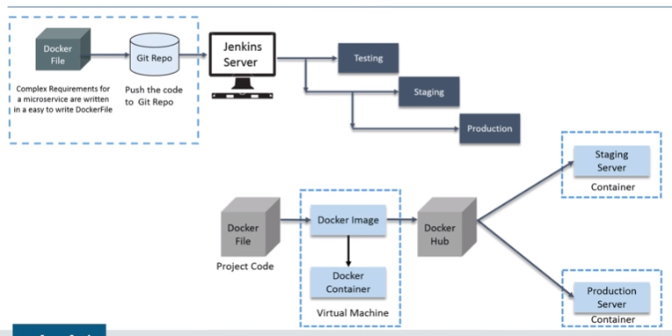
Docker in DevOps

Slide 5
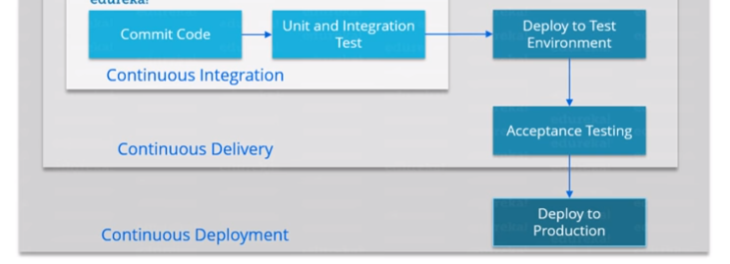
CI/CD

Slide 6
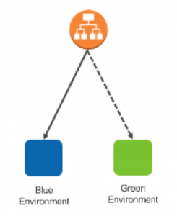
Blue/Green Deployment - Benefits
Blue/green deployments provide a level of isolation between your blue and green application environments.
It ensures spinning up a parallel green environment does not affect resources underpinning your blue environment.
After you deploy the green environment, you have the opportunity to validate it. You might do that with test traffic before sending production traffic to the green environment, or by using a very small fraction of production traffic, to better reflect real user traffic. This is called canary analysis or canary testing

Slide 7
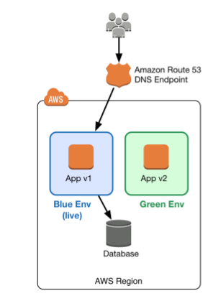
Blue/Green Deployment – Benefits ..Contd
Blue/green deployments also fit well with continuous integration and continuous deployment (CI/CD) workflows, in many cases limiting their complexity.

Slide 8

AWS Tools and Services Enabling Blue/Green Deployments
Amazon Route 53
Amazon Route 53 is a highly available and scalable authoritative DNS service that routes user requests for Internet-based resources to the appropriate destination.
Amazon Route 53 runs on a global network of DNS servers providing customers with added features, such as routing based on health checks, geography, and latency.

Slide 9
AWS Tools and Services Enabling Blue/Green Deployments
Another common approach to routing traffic for a blue/green deployment is through the use of load balancing technologies.
Elastic Load Balancing distributes incoming application traffic across designated Amazon Elastic Compute Cloud (Amazon EC2) instances.
Elastic Load Balancing scales in response to incoming requests, performs health checking against Amazon EC2 resources, and naturally integrates with other AWS tools, such as Auto Scaling.

Slide 10
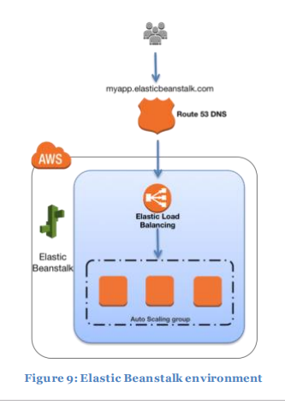
AWS Tools and Services Enabling Blue/Green Deployments
AWS Elastic Beanstalk
AWS Elastic Beanstalk is a fast and simple way to get an application up and running on AWS.
It’s perfect for developers who want to deploy code without worrying about managing the underlying infrastructure.
Elastic Beanstalk supports Auto Scaling and Elastic Load Balancing, both of which enable blue/green deployment

Slide 11
AWS Tools and Services Enabling Blue/Green Deployments
AWS OpsWorks
AWS OpsWorks is a configuration management service based on Chef that allows customers to deploy and manage application stacks on AWS.
Customers can specify resource and application configuration, and deploy and monitor running resources.
OpsWorks simplifies cloning entire stacks when you’re preparing blue/green environments

Slide 12
AWS Tools and Services Enabling Blue/Green Deployments
AWS CloudFormation
AWS CloudFormation provides customers with the ability to describe the AWS resources they need through JSON formatted templates.
This service provides very powerful automation capabilities for provisioning blue/green environments and facilitating updates to switch traffic, whether through Route 53 DNS, Elastic Load Balancing, etc.

Slide 13
AWS Tools and Services Enabling Blue/Green Deployments
Amazon CloudWatch
Amazon CloudWatch is a monitoring service for AWS Cloud resources and the applications you run on AWS.9 CloudWatch can collect and track metrics, collect and monitor log files, and set alarms.
It provides system-wide visibility into resource utilization, application performance, and operational health, which are key to early detection of application health in blue/green deployments.

Slide 14
Blue/Green Deployments - Techniques
Update DNS Routing with Amazon Route 53
DNS routing through record updates is a common approach to blue/green deployments. DNS is the mechanism for switching traffic from the blue environment to the green and vice versa, if rollback is necessary.
This approach works with a wide variety of environment configurations, as long as you can express the endpoint into the environment as a DNS name or IP address.

Slide 15
Blue/Green Deployments - Techniques
· Single instances, with a public or Elastic IP address
· Groups of instances behind an Elastic Load Balancing load balancer, or third-party load balancer
· Instances in an Auto Scaling group with an Elastic Load Balancing load balancer as the front end
· Services running on an Amazon EC2 Container Service (Amazon ECS) cluster fronted by an Elastic Load Balancing load balancer
· Elastic Beanstalk environment web tiers
· Other configurations that expose an IP or DNS endpoint

Slide 16
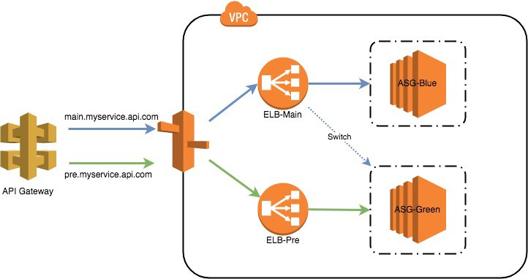
Blue/Green Deployments - Techniques

Slide 17
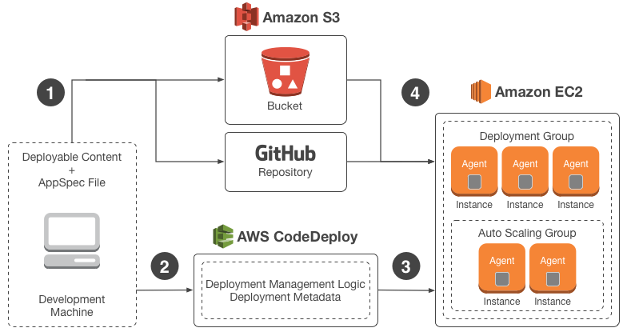
Blue/Green Deployments - Techniques

Slide 18
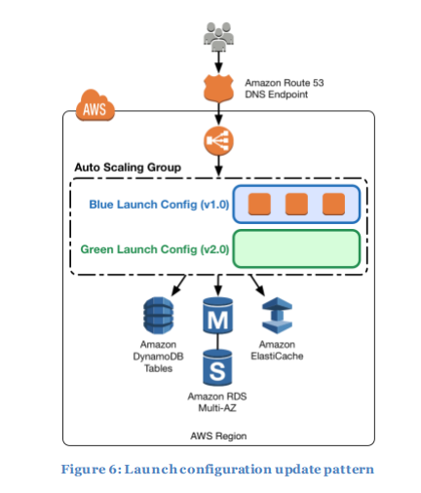
Launch configuration update pattern
Auto Scaling groups have their own launch configurations. A launch configuration contains information like the Amazon Machine Image (AMI) ID, instance type, key pair, one or more security groups, and a block device mapping.

Slide 19
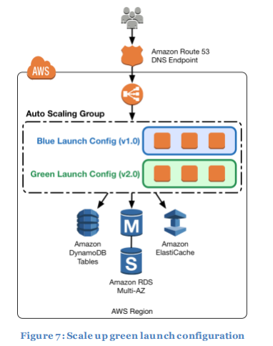
Scale up green launch configuration

Slide 20
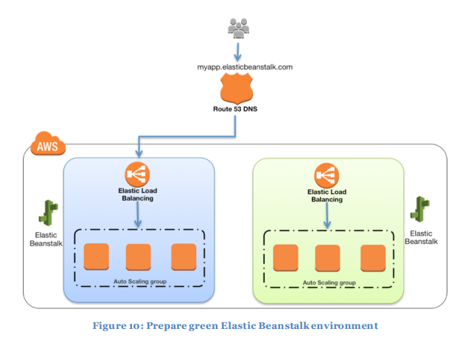
Prepare green Elastic Beanstalk environment

Slide 21
When Blue/Green Deployments Are Not Recommended
Are your schema changes too complex to decouple from the code changes? Is sharing of data stores not feasible?
Does your application need to be “deployment aware”?
This is often a consideration in conjunction with the inability to effectively decouple schema and code changes

Slide 22
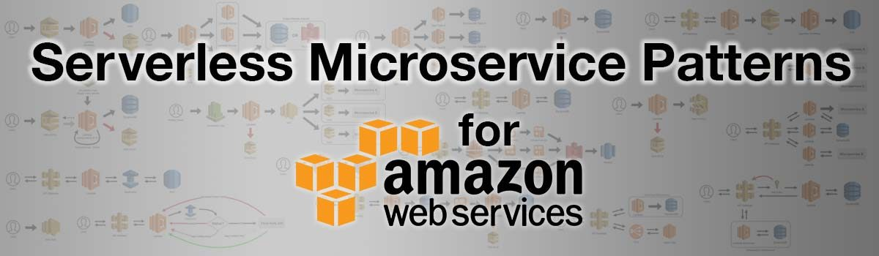
Implementing Serverless Microservices Architecture Patterns
Microservices in Lambda – Stateless which is easy to scale up/down.
Implementing database per service and shared database patterns
Accessing Dynaomdb using Lambda
Accessing Dynamodb directly from API Gateway
Implementing transaction log tailing pattern
Implementing sage pattern

Slide 23

Serverless Microservice Patterns
The Simple Web Service Pattern

Slide 24
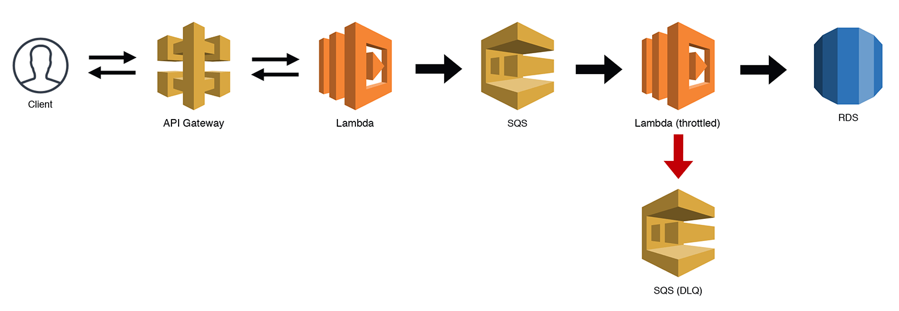
Serverless Microservice Patterns
The Scalable Webhook Pattern
If you’re building a webhook, the traffic can often be unpredictable. This is fine for Lambda, but if you’re using a “less-scalable” backend like RDS, you might just run into some bottlenecks.
There are ways to manage this, but now that Lambda supports SQS triggers, we can throttle our workloads by queuing the requests and then using a throttled (low concurrency) Lambda function to work through our queue

Slide 25
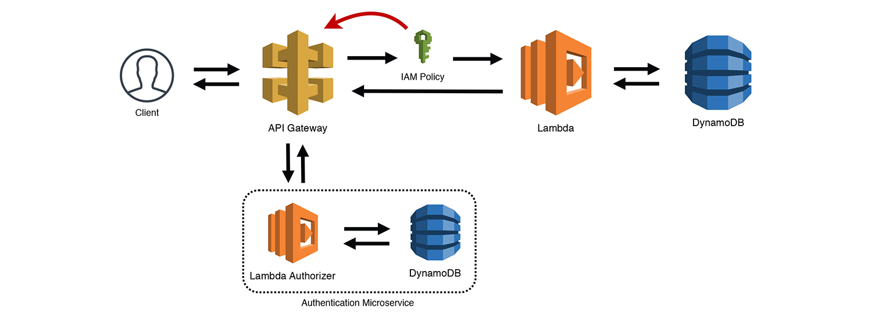
Serverless Microservice Patterns
Gatekeeper Pattern

Slide 26
Serverless Microservice Patterns
Gatekeeper Pattern
This is a variation on the Simple Web Service pattern. Using API Gateway’s “Lambda Authorizers”, you can connect a Lambda function that processes the Authorization header and returns an IAM policy.
API Gateway then uses that policy to determine if it is valid for the resource and either routes the request, or rejects it. API Gateway caches the IAM policy for a period of time, so you could also classify this as the “Valet Key” pattern.

Slide 27

Serverless Microservice Patterns
The Internal API Pattern

Slide 28
Serverless Microservice Patterns
Internal API Pattern
The Internal API pattern is essentially a web service without an API Gateway frontend. If you are building a microservice that only needs to be accessed from within your AWS infrastructure, you can use the AWS SDK and access Lambda’s HTTP API directly.
If you use an InvocationType of RequestResponse, then a synchronous request will be sent to the destination Lambda function and the calling script (or function) will wait for a response.

